Slide 1

Cerebrovascular Disease
Jason Massa D.O.
IS-MSN Fall 2021

Slide 2
Learning Objectives
Acute Ischemic Stroke:
Appreciate and be able to counsel your patients regarding risk of stroke based on risk factors
Participate in the evaluation and treatment of patients presenting with acute stroke syndromes.
Initiate therapies for secondary stroke prevention.
Transient Ischemic Attack
Understand the work up for a patient presenting with transient neurologic deficits and differentiate from acute stroke syndrome.
Initiate therapies to reduce risk of future stroke.
Cardioembolic stroke
Appreciate the tell-tale signs of a cardioembolic stroke based on risk factors, history and diagnostic work up.
Understand benefits and potential risks for treatment depending on cause and stratification of this patient population.
Intracerebral Hemorrhage
Know the most common causes and their differentiating characteristics.

Slide 3
Learning Objectives
Subarachnoid Hemorrhage:
Recognize clinical presentation of subarachnoid hemorrhage
Understand the different types of subarachnoid hemorrhage and risk factors
Initiate therapies for hemorrhage and prevention of further bleeding
Venous Sinus Thrombosis
Understand the diverse clinical presentation of DVST
Recognize significant risk factors, most susceptible populations.
Initiate therapies to reduce morbidity and mortality.

Slide 4
Definitions

Slide 5
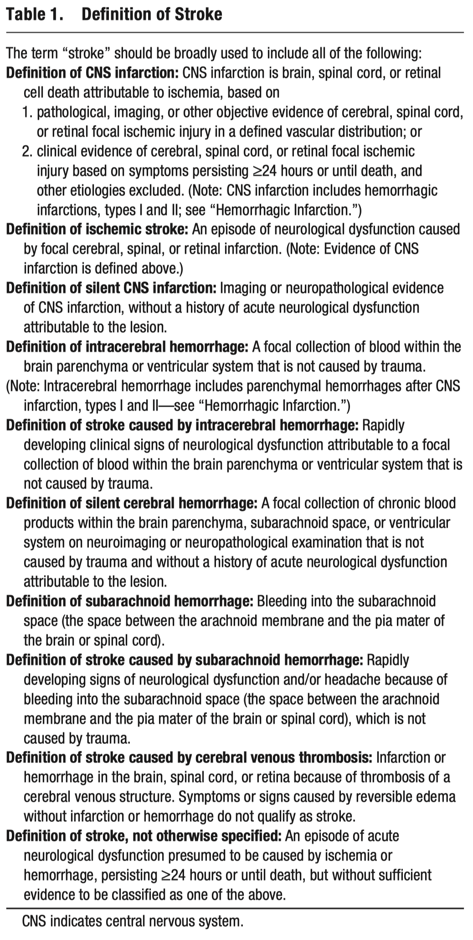
What is a Stroke?
Lack of oxygen to the brain or spinal cord resulting in ischemia and/or infarction
Causes:
Ischemic stroke
Can be ‘silent’ or without symptoms
Hemorrhagic stroke
Intracerebral hemorrhage
Subarachnoid hemorrhage
Cerebral venous thrombosis
Other: “Stroke, NOS”

Slide 6
Time is brain…
A sudden onset of neurological deficit is the unifying concept in stroke
Stroke is a clinical diagnosis
Rapid bedside assessment establishes a diagnosis of stroke but not underlying mechanism
To distinguish among different mechanisms requires imaging and sometimes laboratory workup
Ischemia refers to inadequate blood flow, causes include:
Embolism
Thrombosis
Hemorrhage
Infarct is cell death, time is brain

Slide 7
Different strokes for different folks
Ischemic stroke
Large Vessel Occlusion
Small Vessel Occlusion
Cardioembolic
Hemorrhagic stroke
Intracerebral hemorrhage
Subarachnoid hemorrhage
Venous thrombosis
Artery-Artery embolism

Slide 8
Epidemiology
Condition | 2000 | 2015 | 2016
All Causes | 869 | 733 | 728.8
Heart Dz | 257.6 | 168.5 | 165.5
Cancer | 199.6 | 158.5 | 155.8
Chronic Lower Resp | 44.2 | 41.6 | 40.6
Unintent. Injuries | 34.9 | 43.2 | 47.4
STROKE | 60.9 (RANK 3) | 37.6 | 37.3 (RANK 5)
Alzheimer Dz | 18.1 | 29.4 | 33.3
Diabetes | 25 | 21.3 | 21
Influenza/Pneum. | 23.7 | 15.2 | 13.5
Nephritis | 13.5 | 13.4 | 13.1
Suicide | 10.4 | 13.3 | 13.5
Stroke is the second most common cause of mortality and third most common cause of disability worldwide.
Globally, 68% of all strokes are ischemic and 32% are hemorrhagic.
In the US:
5TH Leading Cause of Death in US (2016)
87% of all strokes are ischemic
10% hemorrhagic
3% being subarachnoid hemorrhage
A stroke occurs every 40 seconds in the US
Every 3 minutes and 42 seconds a death from stroke occurs in US (2016)

Slide 9
Acute Ischemic Stroke and TIA

Slide 10
Ischemic Stroke
Large Vessel Occlusion
Small Vessel or Lacunar Infarct
Local (in situ) thrombosis within the small arteries causes infarct directly in the tissue where it starts
Blood clot, air, septic debris, or fat is launched into the cerebral vasculature by the heart
Cardioembolic stroke
Due to thrombotic or embolic occlusion of the major arteries of the brain like the internal carotid artery, middle cerebral artery, anterior cerebral artery or the vertebrobasilar system

Slide 11
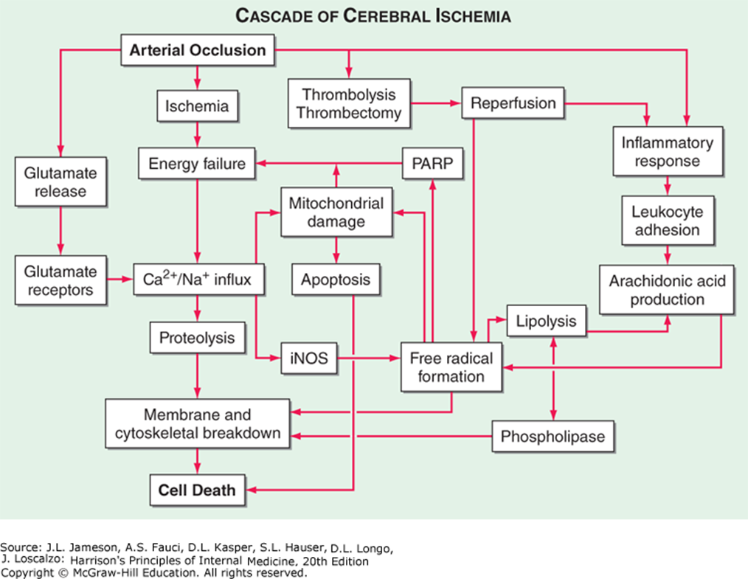
Notes:
Cascade of Cerebral Ischemia.
iNOS- inducible nitrous oxide synthetase
PARP- poly-A-ribose polymerase
Neurons are starved of glucose and O2, which results in mitochondrial failure to produce ATP. Without ATP, membrane ion pumps stop functioning and neurons depolarize, allowing intracellular CA to rise. Cellular depolarization causes glutamate release from synaptic terminals, then activating post-synaptic glutamate receptors, which increase CA influx, which is neurotoxic. Free radicals produce degradation of membrane lipids and mitochondrial dysfunction; cause destruction of membranes.

Slide 12
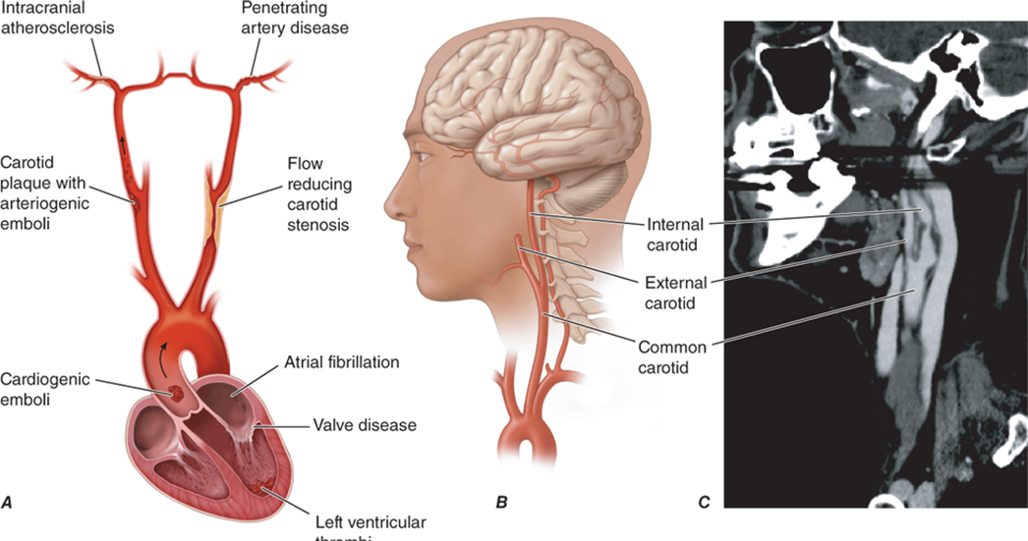
Pathophysiology
Notes:
Pathophysiology of ischemic stroke. A. Diagram illustrating the three major mechanisms that underlie ischemic stroke: (1) occlusion of an intracranial vessel by an embolus that arises at a distant site (e.g., cardiogenic sources such as atrial fibrillation or artery-to-artery emboli from carotid atherosclerotic plaque), often affecting the large intracranial vessels; (2) in situ thrombosis of an intracranial vessel, typically affecting the small penetrating arteries that arise from the major intracranial arteries; (3) hypoperfusion caused by flow-limiting stenosis of a major extracranial (e.g., internal carotid) or intracranial vessel, often producing “watershed” ischemia. B. and C. Diagram and reformatted computed tomography angiogram of the common, internal, and external carotid arteries. High-grade stenosis of the internal carotid artery, which may be associated with either cerebral emboli or flow-limiting ischemia, was identified in this patient.

Slide 13
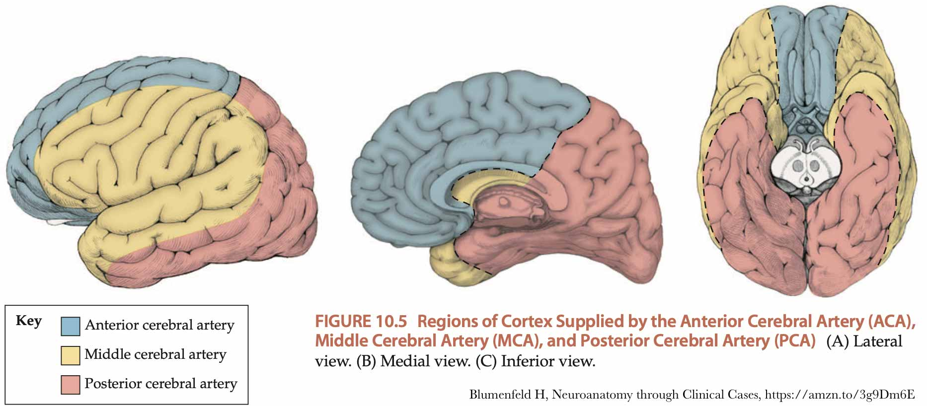
Vascular territories

Slide 14
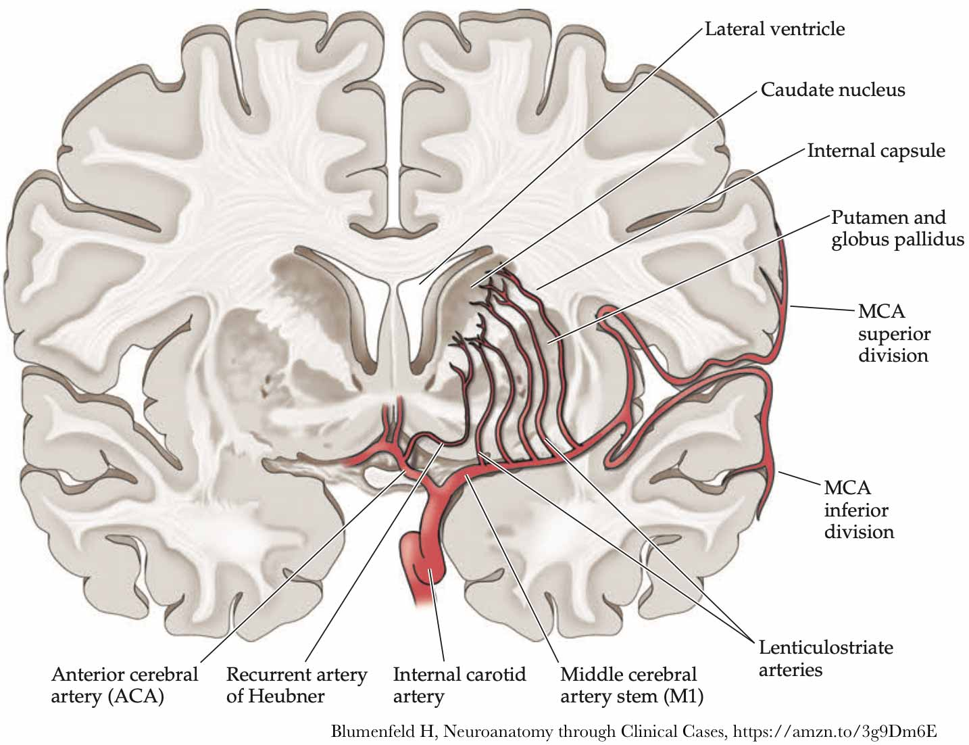
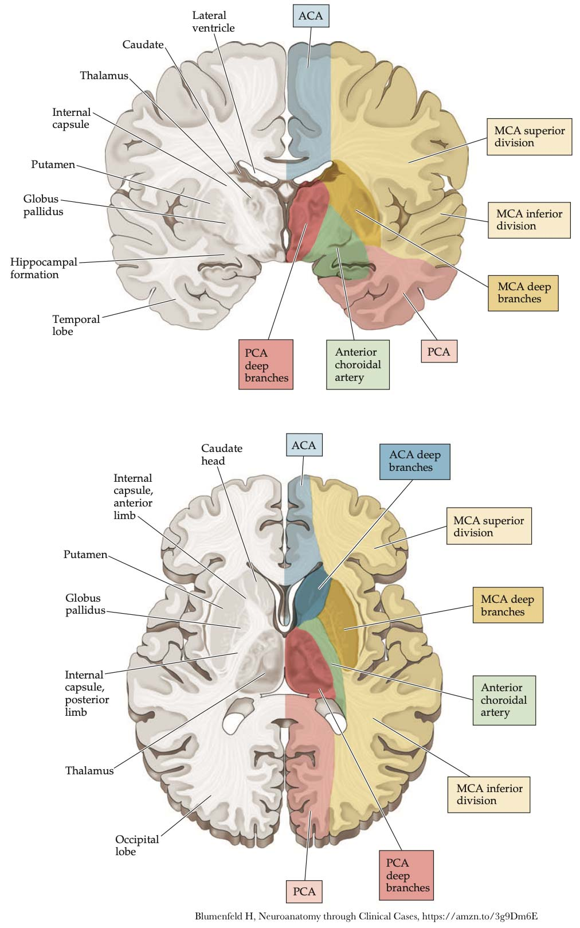
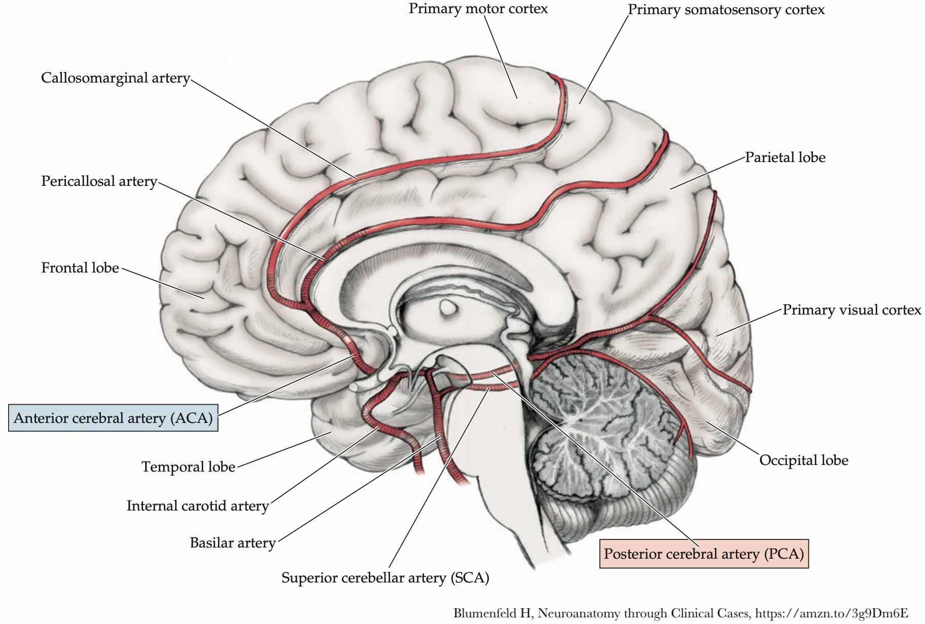

Slide 15
Mechanisms of acute ischemic stroke
Vascular thrombosis
Atherosclerosis (extracranial or intracranial), dissection (spontaneous or traumatic), vasculopathies (Moyamoya, fibromuscular dysplasia, vasculitis)
Embolic etiologies
Atherosclerosis (proximal artery embolism), cardioembolic (afib, endocarditis, PFO)
Hypercoagulable states affecting arteries
Malignancy, antiphospholipid syndrome
Venous hypertension, hypercoagulable states affecting veins
Dural sinus thrombosis due to malignancy, antiphospholipid syndrome, factor V leiden, protein C or S deficiency
Paradoxical embolism: DVT or another venous thrombus makes its way through a PFO to the left side of the heart to cause a cardioembolic stroke

Slide 16

Risk Factors
Modifiable Risk Factors Include:
Hypertension
Diabetes mellitus
Cardiac disease
High cholesterol
Carotid stenosis
Atrial Fibrillation
Lifestyle issues: Excessive alcohol intake, tobacco use, illicit drug use, physical inactivity
Obesity
Oral contraceptive use/postmenopausal hormone use (probably estrogen more than progesterone)
Non-Modifiable Risk Factors Include:
Age
Race
Sex
Ethnicity
Family history of stroke or transient ischemic attacks (TIAs)

Slide 17
Clinical Presentation
Many different clinical presentations, depending on location of the stroke
Examples of chief complaints:
Weakness
Numbness
Difficulty speaking
Difficulty walking
Confusion
‘not right’
Stroke should be considered in any sudden onset neurologic deficit
Your stroke syndromes lecture focused on combinations of deficits commonly seen in stroke, today we’re more interested in how to proceed after the diagnosis is made
Notes:
Highly variable dependent on location of the infarct. AIS and hemorrhagic stroke can be clinically indistringuishable. Your localization skills are important here. Symptoms and exam should make physiologic sense, but don’t be too rigid with this as you can miss rare stroke syndromes.

Slide 18
Differential Diagnosis Considerations
Consider different mechanisms of stroke
Transient Ischemic Attack (TIA)
Seizure and post-ictal paralysis
Migraine with Aura
Functional neurologic deficit
Cerebral Amyloid Angiopathy

Slide 19
Treatment/management principles
Time is Brain
Once acute ischemic stroke is suspected, rapid determination of eligibility for acute interventions is needed
Every minute brain is deprived of blood flow leads to irreversible ischemia and neuronal death.
Acute interventions for ischemic stroke include:
Acute thrombolysis with IV tPA
Mechanical Thrombectomy for large vessel occlusion
Patients may get both, one or neither of these interventions depending on many factors

Slide 20
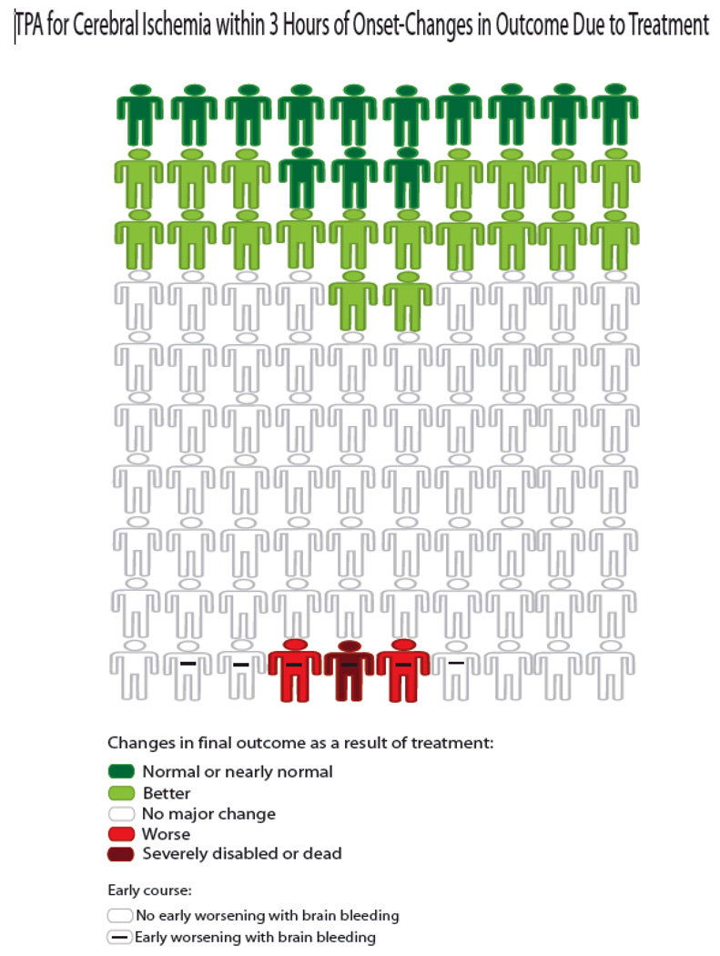
IV tPA – Mechanism of action and establishment of efficacy
Binds to fibrin within a clot
Converts entrapped plasminogen to plasmin
Proven to improve outcomes when given in accordance with strict inclusion/exclusion criteria
NINDS 1995
ECASS 2008
SITS-MOST 2007
Notes:
Tissue plasminogen activator for acute ischemic stroke. The National Institute of Neurological Disorders and Stroke rt-PA Stroke Study Group. N Engl J Med 1995;333(24):1581–1587. doi:10.1056/ NEJM199512143332401.
Hacke W, Kaste M, Bluhmki E, et al. Thrombolysis with alteplase 3 to 4.5 hours after acute ischemic stroke. N Engl J Med 2008;359(13):1317–1329. doi:10.1056/NEJMoa0804656.
Wahlgren N, Ahmed N, Dávalos A, et al. Thrombolysis with alteplase for acute ischaemic stroke in the Safe Implementation of Thrombolysis in Stroke-Monitoring Study (SITS-MOST): an observational study. Lancet 2007;369(9558): 275–282. doi:10.1016/S0140-6736(07)60149-4.

Slide 21
Acute thrombolysis with IV tPA: eligibility algorithm
Establish a last known well time (LKWT)
Focused neurological exam with National Institutes of Health Stroke Scale (NIHSS)
Brief medication history (e.g., anticoagulants) to assess contraindications to therapy
Non contrast head CT to rule out hemorrhage
Labs: fingerstick blood glucose, coagulation studies such as PT-INR, PTT, platelet count, and renal functions such as creatinine
Fingerstick glucose: technically only lab REQUIRED before IV tPA can be administered (caveats apply)
Coagulation studies: abnormalities on these labs can be exclusion criteria for IV tPA

Slide 22
Physical Examination
Urgency of the evaluation will dictate the level of detail in your exam
NIHSS – national institutes of health stroke scale
Standardized neurologic assessment for high yield stroke exam findings
All providers should have training on NIHSS
Scored 0 to 42 (higher is worse)
Reliable and validated screening tool for stroke assessment
Less sensitive to posterior circulation stroke syndromes

Slide 23
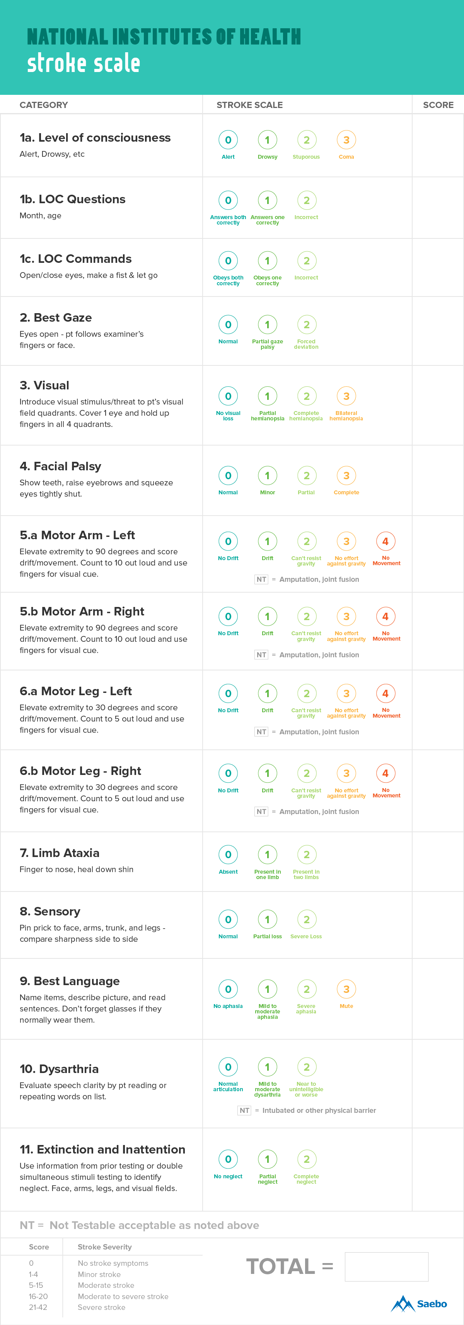
NIHSS
If you will be doing a neurology, ER, or critical care rotation, please visit this website and complete your NIHSS certification. It will be invaluable when you get to third year.

Slide 24
NIHSS Instruction
Administer stroke scale items in the order listed.
Record performance in each category after each subscale exam.
Do not go back and change scores.
Follow directions provided for each exam technique.
Scores should reflect what the patient does, not what the clinician thinks the patient can do.
The clinician should record answers while administering the exam and work quickly.
Except where indicated, the patient should not be coached (i.e., repeated requests to patient to make a special effort).

Slide 25
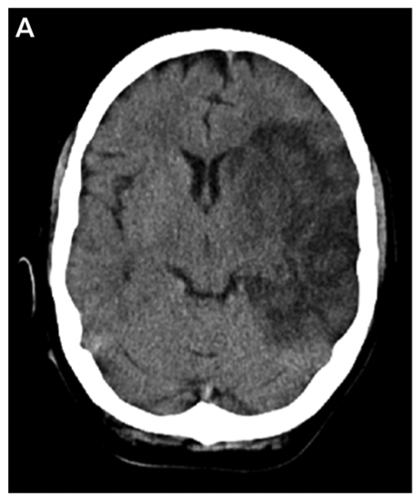

Initial Imaging in Acute Stroke
Always:
CT Head wo contrast
Weakness for posterior fossa strokes
Sometimes:
CT Angiogram
CT Perfusion
MRI Brain wo contrast
MR Angiogram
MR Perfusion
*probably not a tPA candidate

Slide 26
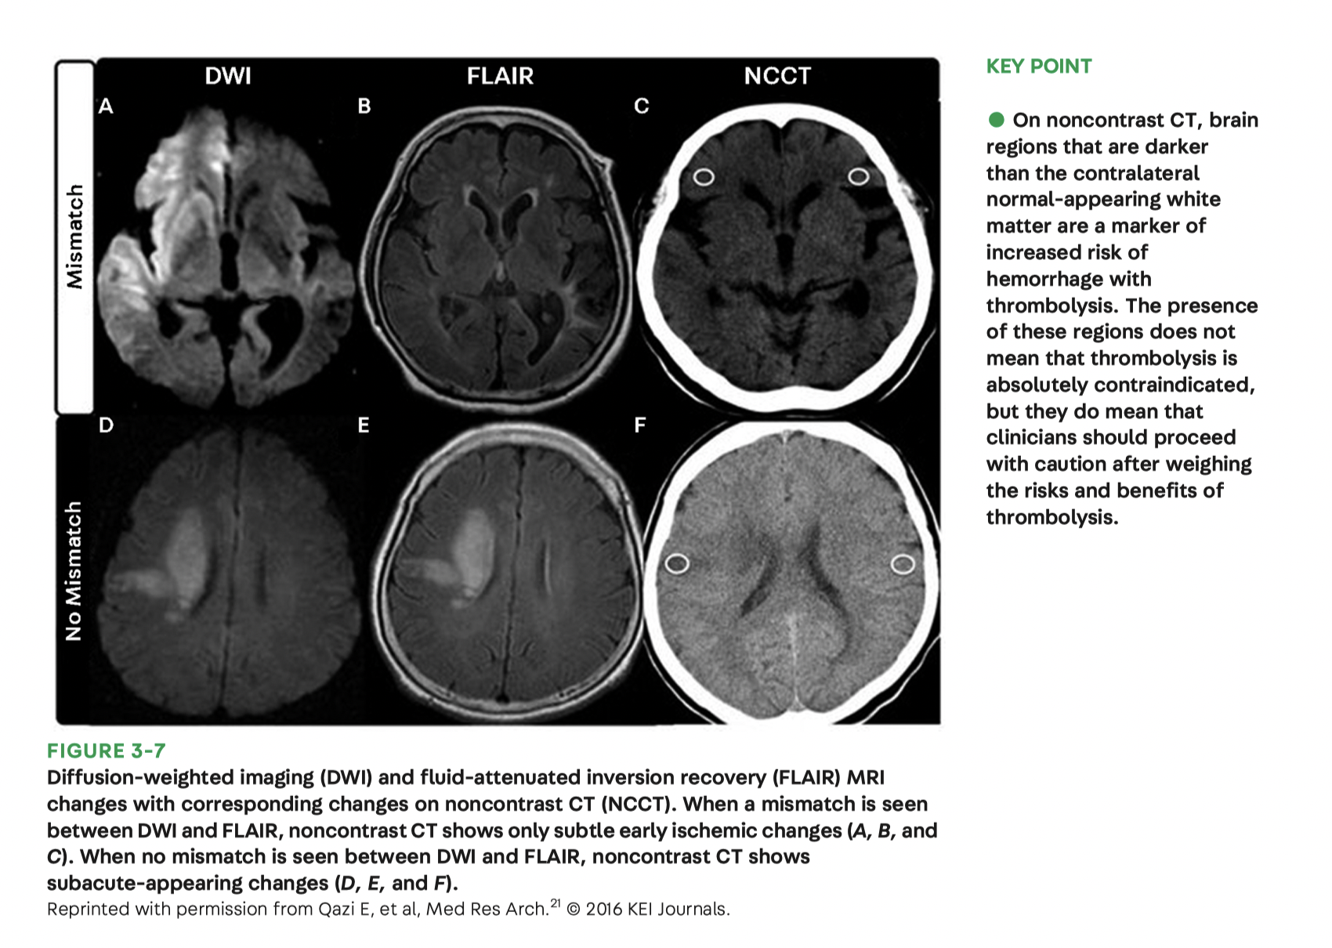
Imaging in acute stroke

Slide 27
History
Step 1: Establish the time of onset of stroke which starts the clock on all subsequent time windows and management decisions.
“When was the patient last seen well?”
“When was the patient last seen normal?”
“When was the patient last known well?” (LKW)
Write down the time, ex: 8:45 am; not “45 minutes ago”.
Step 2: History of the presenting symptom (which will help distinguish mimics from stroke). Temporal onset needed. Stroke is “abrupt”, not gradual like migraine for instance. Are symptoms “stuttering”, fluctuating, improving?
Step 3: PMHX (to determine risk factors and eligibility for IV rtPA)
Notes:
Hx of anticoagulants, recent trauma, bleeding, recent hospitalizations. May need family member to answer the questions.

Slide 28
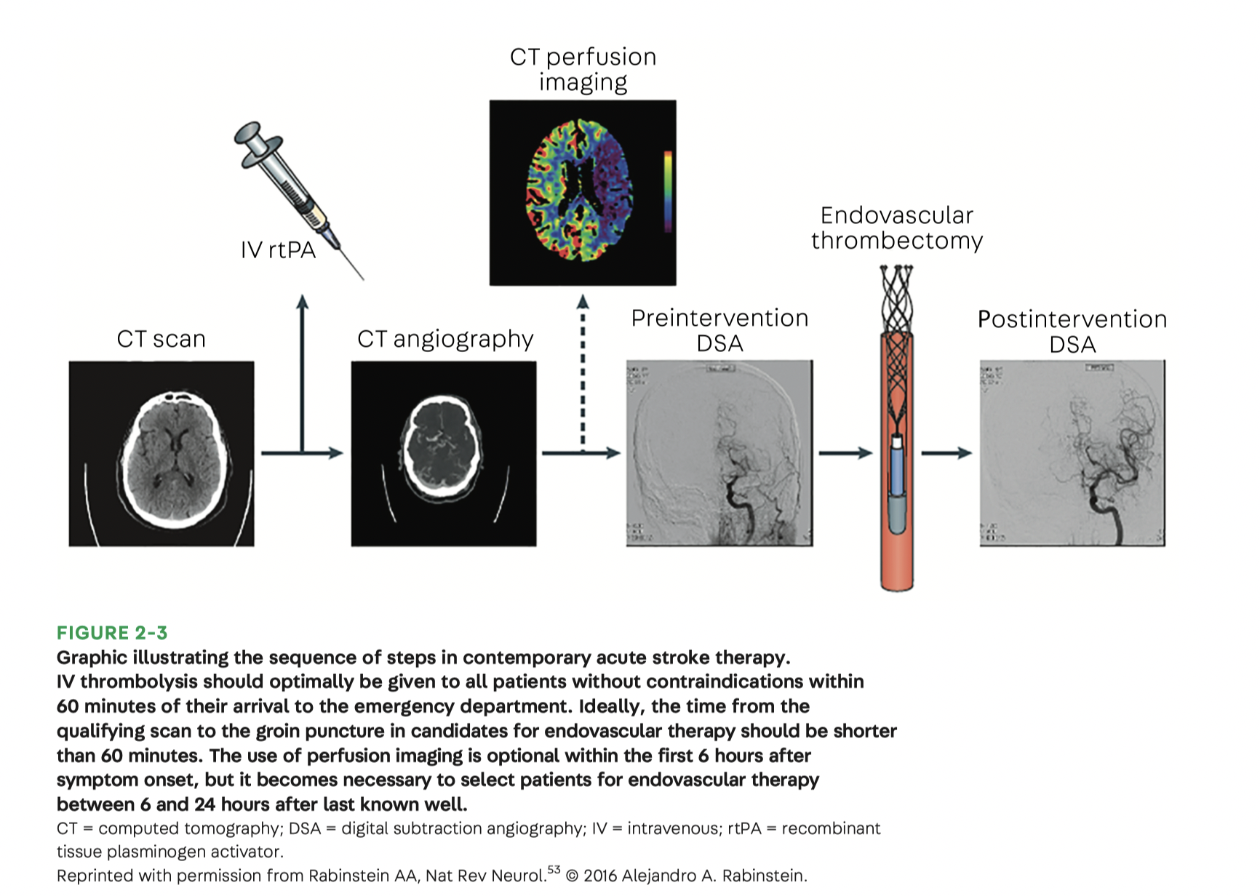
Treatment algorithm

Slide 29
Acute thrombolysis with IV tPA
Window to administer IV tPA: within 4.5 hours from LKWT
Benefit of tPA when given within 3 hours of LKWT:
13% return to baseline
19% will have some functional improvement
Risks of tPA when given within 3 hour window:
6% chance of hemorrhage
Data supports use of tPA in extended window of 3-4.5 hours from LKWT in select patients:
Age >18 yo and <80 yo
NIHSS <25
Ischemic injury on CT <1/3 of MCA territory
Excludes patients with history of stroke AND diabetes

Slide 30
Contraindications to IV tPA
Absolute contraindications
CT shows hemorrhage or large hypodensity in the area with suspected
Treatment with anticoagulation
INR >1.7 or platelet count <100,000
Blood glucose <50 mg/dL
Significant head trauma, intracranial or intraspinal surgery withing previous 3 months
Recent LP
Blood pressure sustained over 185/110 mmHg
Relative contraindications
Pregnancy
Stroke or myocardial infarction in previous 3 months
Major trauma in previous 14 days
History of ICH, unruptured and unsecured intracranial aneurysm, AVM, or intracranial neoplasm
Arterial puncture in previous 7 days

Slide 31
Post IV tPA management
Admission to ICU for close neurological monitoring
Neurological and BP checks every 15 minutes during infusion, every 30 min for 6 hours after, and every hour for 24 hours
No antiplatelet agents, anticoagulation, or DVT prophylaxis for 24 hours after tPA
Blood pressure goal SBP <180, DBP <105
Complications:
Any acute neurological change, severe headache or vomiting should prompt repeat CT brain to assess for hemorrhagic transformation

Slide 32
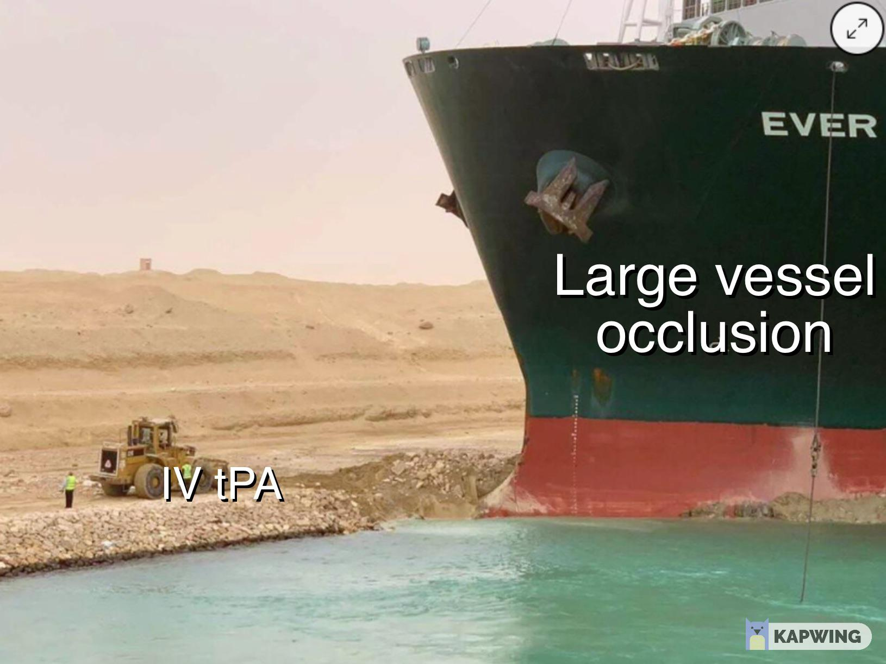
Mechanical Thrombectomy for Large Vessel Occlusion

Slide 33
Mechanical Thrombectomy for Large Vessel Occlusion
Patients should be considered for mechanical thrombectomy within 6 hours of LKWT if there is a large vessel occlusion in the anterior circulation that is accessible by catheterization (carotid terminus, M1 or proximal M2 segment of MCA)
Perfusion imaging (CT or MRI) provides information on infarct and potentially salvageable tissue, characterized by mismatch ratio and volume of infarct
Patients who have completed their infarcts (no salvageable tissue on imaging) are unlikely to benefit from thrombectomy
Several studies have shown benefit of thrombectomy in addition to tPA over IV tPA alone – i.e. you can get thrombectomy even if you already got tPA if you meet criteria
NNT of 2.6!!!!

Slide 34
Extended Window for Thrombectomy
DAWN trial and DEFUSE3 trials used perfusion imaging to identify patients >6 hours, and less than 24 hours (DAWN) or 16 hours (DEFUSE3) that might benefit from thrombectomy at even greater time periods
These studies showed benefits, with NNT between 2 – 4.
While not completely standard of care at this point, most large comprehensive stroke centers will perform thrombectomy up to 24 hours in the right situation
Important for ‘wake up strokes’ and when clear time of onset is unclear but LKW unlikely to be close to actual time of onset

Slide 35
Subacute stroke
These patients aren’t candidates for tPA or thrombectomy
Permissive hypertension: practice varies between normotensive, 20% reduction from admission BP or allowing SBP <220mmHg
Antiplatelet agents such as aspirin full dose (325mg) or clopidogrel (if aspirin intolerant) should be given within 24 hours if no contraindications
Investigate stroke etiology
Echocardiogram
Carotid imaging
Telemetry monitoring
Focus on early PT/OT/ST
Secondary stroke prevention

Slide 36
Secondary Stroke Prevention (for all stroke patients whether they got tPA/thrombectomy or not)
All patients should be assessed for co-morbidities that place them at high risk for another stroke
Antiplatelet therapy: aspirin
Anticoagulation: for patients with atrial fibrillation, hypercoagulable states, intra-cardiac thrombus/device, mechanical valves
Echocardiogram
30-day event monitor if no afib in hospital
Blood pressure control
Hyperlipidemia: all stroke patients should get high dose statin therapy (atorvastatin 40mg or higher, or equivalent)
Glucose control: screen for diabetes
Smoking cessation
Carotid revascularization should occur within 2 weeks of index event if indicated and no contraindications
Carotid imaging

Slide 37
Malignant Hemispheric Stroke
MCA or combined ACA/MCA stroke in either hemisphere which involves at least 2/3 of the territory…this is a BIG stroke
High probability for malignant cerebral edema and brain herniation
High mortality
Consider intubation, high risk for loss of airway control
High risk for hemorrhagic transformation
Decompressive hemi-craniectomy within 48 hours in patients <60 yo to decrease mortality and improve functional outcomes, though there is great variability in this practice.

Slide 38
Case Example
7:15pm - You are notified that EMS is bringing in a suspected stroke:
55 year old man
Hx of atrial fibrillation, hypertension, type 2 diabetes
Patient was with family sitting down to dinner at 7:00pm when he was witnessed to begin struggling to speak, right facial droop, unable to hold his utensils.
No previous neurologic deficits, was in his normal state of health immediately prior to onset of symptoms.
ETA 15min…
Notes:
EMS will triage first to comprehensive stroke centers (thrombectomy capable,) then to primary stroke centers.
Stoke protocols will be activated, can vary from hospital to hospital but generally include notifying the ED and neurologist, as well as the interventional radiology team for possible thrombectomy.
At this point all you know is that this patient has multiple vascular risk factors with acute onset of focal neurologic deficits. (which localize pretty well)

Slide 39
Case Example
Stroke team activate!
Usually, initiated by the emergency room
Notification goes out to neurology team, interventional radiology/neurology/neurosurgery
Pharmacy, CT, and MRI are notified as well
Usually, a trauma room is readied for the patient to facilitate rapid assessment

Slide 40
Case Example
On arrival you quickly collect some more history from the patient’s family:
Patient was on coumadin for the afib, but stopped the medication last week for a dental procedure
His hypertension and diabetes have been well managed, and he has been compliant with medications
No recent infections, no medication changes, he works full time as a CPA, non-smoker, social drinker.
Meds: lisinopril, metformin, (coumadin)
No recent procedures or surgeries
No history of clotting disorders

Slide 41
Case Example
Exam:
General - anxious, no acute distress otherwise
CV – irregular rate, normal S1 S2, good distal pulses,
Mental Status:
Alert, language deficits limit orientation eval
Speech is densely dysarthric, halting, hesitant. Naming, repetition, and comprehension are all impaired
Leftward gaze preference
Right homonymous hemianopia
Right forehead-sparing facial droop
Right pronator drift
Right arm > leg weakness
Right hemianaesthesia
Right sided reflexes are slightly brisker than the left
NIHSS - 15
Vitals
HR: 85
BP: 175/89
Temp: 98.6
RR: 14

Slide 42
Case Example
CT Head shows no acute abnormalities
Clear time of onset, no contraindications
Push tPA!
Hope for green
CT Angio can then be done to eval for LVO and decide on eligibility for clot retrieval

Slide 43
Hemorrhagic Stroke

Slide 44
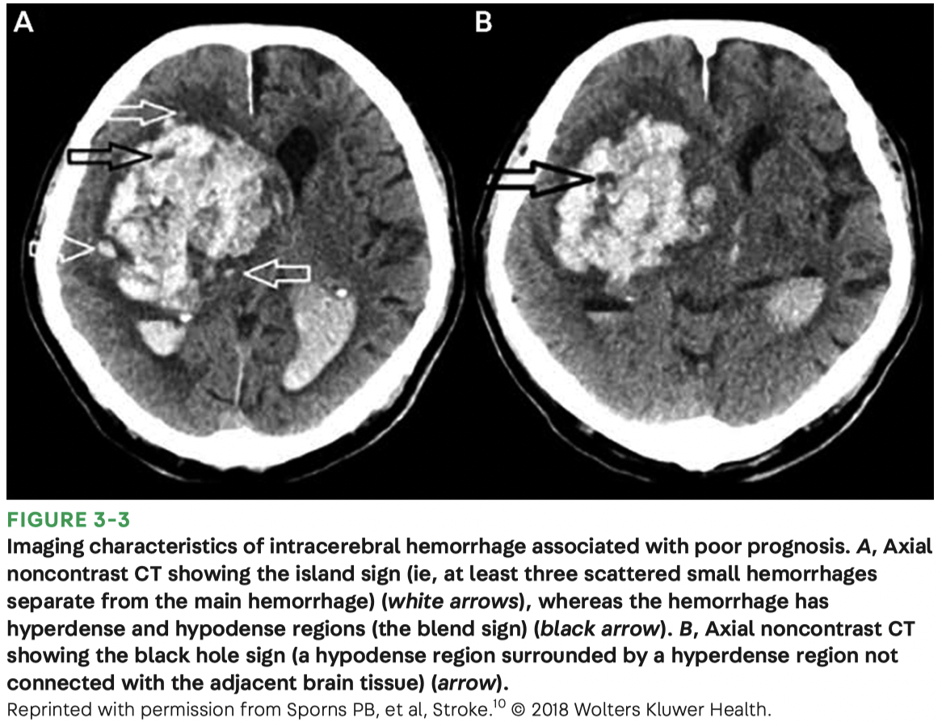
Intracerebral Hemorrhage (ICH)
Usually presents with acute neurological deficits and progressive clinical decline due to hematoma expansion, cerebral edema, and medical complications
Close monitoring, prompt intervention focused on BP control, reversal of coagulopathy, and supportive care to minimize secondary injury are essential
Differential diagnosis: ischemic stroke, TIA, SAH, subdural hematoma, meningitis, encephalitis, brain neoplasm, hypertensive emergency, migraine, acute hypoglycemia, hyper/hyponatremia

Slide 45
ICH pathophysiology
2 most common etiologies
Chronic arterial hypertension
Leads to lipohyalinosis of lenticulostriate arteries, small thalamic arteries, and pontine perforators
ICH occurs in deep grey matter (basal ganglia, thalamus), pons, and cerebellum
Cerebral amyloid angiopathy
Causes deposition of beta-amyloid in walls of small to medium sized leptomeningeal and cortical vessels
Elderly (>65 yo)
Leads to cortical-subcortical (lobar) hemorrhages

Slide 46
Clinical presentation
Focal neurological deficit depending on location
Depressed level of consciousness
Headache
Nausea/vomiting (elevated ICP, cerebellar location, hydrocephalus)
Severe hypertension common
Seizures associated with cortical involvement
Progressive clinical deterioration in the acute phase due to ongoing hematoma expansion (in 1/3 of patients within first 3 hours) – things get bad FAST

Slide 47
Risk factors/triggers
Most common trigger: noncompliance with antihypertensive medication and chronic hypertension
Physical activities that raise BP
Supratherapeutic INR
Sympathomimetic drug use (cocaine, amphetamines)
Trauma
Prior stroke
Male gender
Age >55
Heavy alcohol consumption
Liver dysfunction
Peripartum period

Slide 48
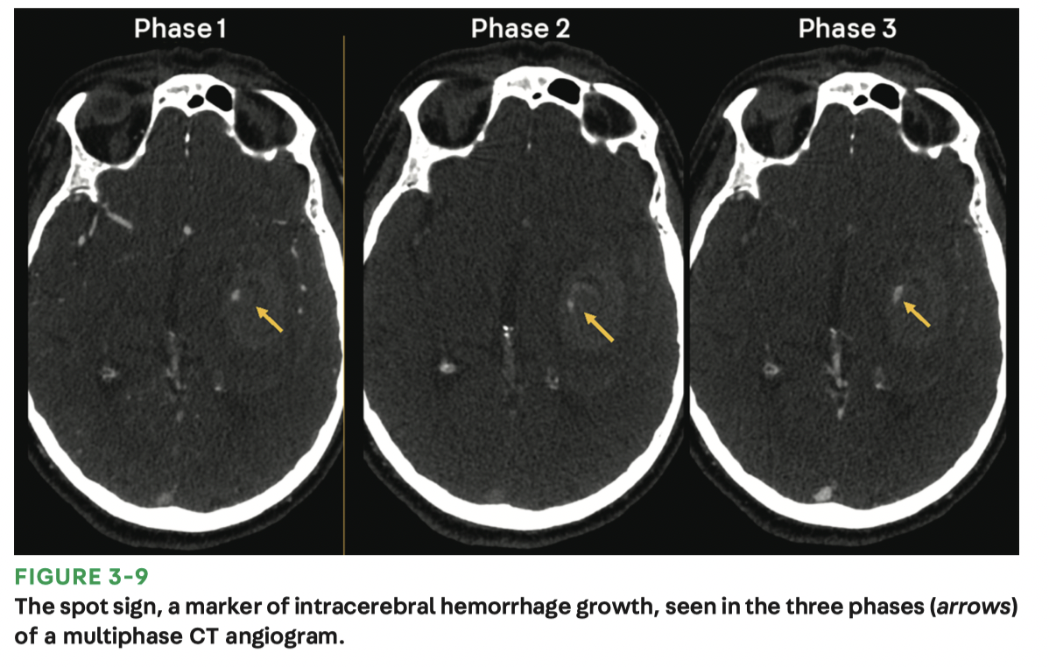
Work up
Neurological emergency – any level of suspicion should lead to expedited assessment
Obtain brief medical history from patient or bystander on time of onset, vascular risk factors, history of htn, medications, illicit drug use, recent head trauma, history of prior stroke, and baseline cognitive status
Labs: urine drug screen, chemistry, cbc, pt/ptt, anti-Xa level
Imaging: non contrast head CT (sensitivity/specificity near 100% in 1st week)
Adding contrast (CTA) may permit visualization of ‘spot sign’ representing active extravasation into hematoma – associated with expansion and increased mortality, and may identify underlying vascular anomalies

Slide 49
Treatment/management principles
ICU admission: risk of early deterioration and cardiorespiratory compromise
Blood pressure management
Current AHA guidelines recommend targeting SBP <140mmHg
May require continuous infusion of IV antihypertensives (nicardipine, clevidipine)
Coagulopathy management
Discontinue antiplatelet or anticoagulant medications
Warfarin reversal: vitamin K + prothrombin complex concentrate (kcentra) preferred over fresh frozen plasma (FFP)
Idarucizumab for dabigatran reversal
Routine platelet transfusion should be avoided in spontaneous ICH

Slide 50
Treatment/management principles
Treatment of elevated ICP and hydrocephalus
Hydrocephalus complicates up to 50% of cases
More common in younger patients, with lower GCS, and deep hemorrhages
Consider placement of an ICP monitor if GCS <8, evidence of herniation, extensive interventricular hemorrhage or hydrocephalus
Seizures
No prophylaxis for spontaneous or non traumatic ICH
Treat seizures if they occur
Low threshold for cEEG monitoring in cases of depressed mental status out of proportion to ICH – rule out non convulsive status epilecticus

Slide 51

Treatment/management principles
Neurosurgical intervention
Current evidence does not show benefit of prophylactic early surgery in the setting of supratentorial ICH
Patients with cerebellar hemorrhage >3cm in diameter or with symptomatic mass effect should have emergent surgical decompression to prevent herniation!
Fever Control
Fever is common in ICH and associated with worse outcomes
Treat fevers >38.5C – acetaminophen, chilled saline infusion, cooling blankets
*in contrast to malignant mca infarct

Slide 52
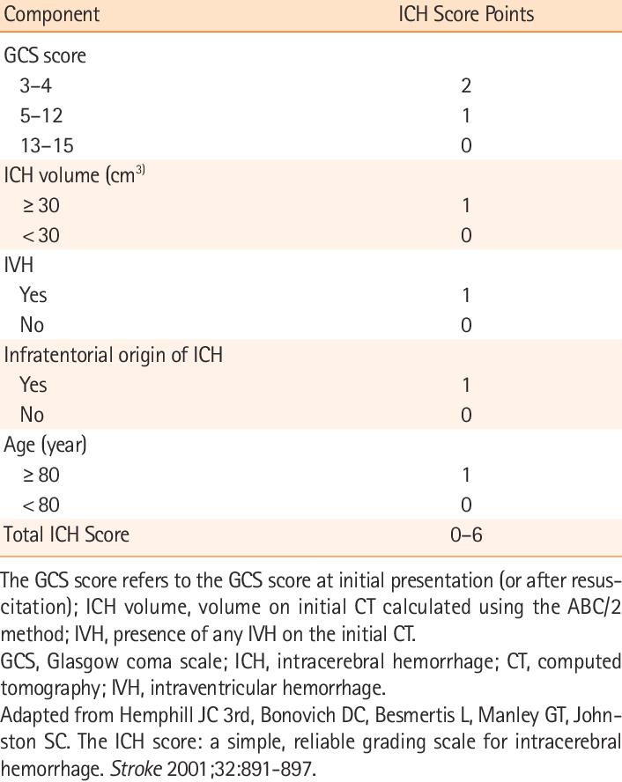
Prognosis
Mortality from ICH remains high (40% at 30 days) – depends on patient, hematoma location, volume, active extravasation.
Only 12-39% of patients achieve functional independence post discharge – high morbidity!
ICH score: ranges from 0-6
Higher score = higher 30-day mortality
Remember that initial aggressive care is indicated for all patients regardless of score – otherwise it’s a self-fulfilling prophecy!
Current guidelines discourage withdrawal of life sustaining treatments in the first 24 hours

Slide 53
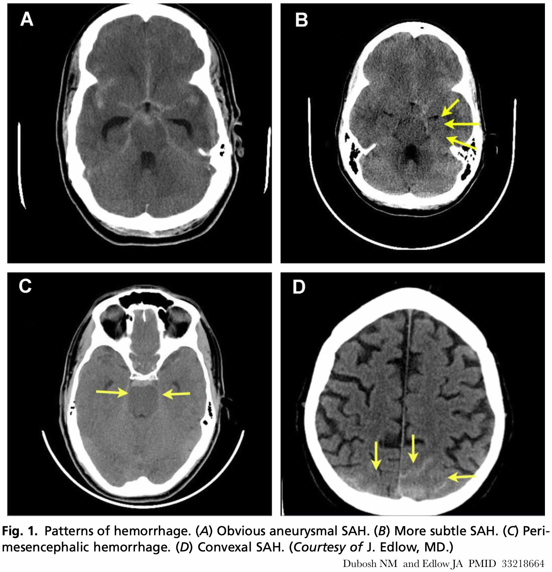
Subarachnoid Hemorrhage
Neurological emergency associated with significant morbidity and mortality
Outcomes greatly impacted by early recognition and aggressive treatment
2 main etiologies
Traumatic
Non traumatic
Aneurysmal (80%) - aSAH
Non aneurysmal

Slide 54
Epidemiology / Risk Factors
3rd most common cerebrovascular disorder after ischemic stroke and ICH
Based on autopsy studies – prevalence of unruptured intracranial aneurysms in adults is 1-5%
Worldwide incidence of aSAH 2-16/100,000 adults. In the US 9-14/100,000 adults
Higher incidence in women (2:1), African-Americans, Hispanics, and age >55 yo
Risk factors:
Hypertension, smoking, alcoholism.
Family history of SAH or another aneurysm.
Autosomal Dominant Polycystic kidney disease, Ehlers-Danlos syndrome, fibromuscular dysplasia, Marfan’s syndrome
Sympathomimetic use (e.g., cocaine, amphetamine).

Slide 55
Pathophysiology
Occurs due to extravasation of blood into subarachnoid space under high hemodynamic pressure
80% of spontaneous, non traumatic SAH is due to aneurysm rupture
Aneurysms at vessel bifurcations due to defects in tunica media and elastica - pathologic dilations at major branching brain arteries
Other theories include inflammatory process affecting cerebral vasculature or disruption of internal elastic membrane from hemodynamic forces
Non-aneurysmal causes:
Rupture of dissections
Arterial blisters
Trauma
Uncommon causes: vascular malformations, coagulopathy, vasculitis, moyamoya, amyloid angiopathy, sympathomimetic exposure

Slide 56
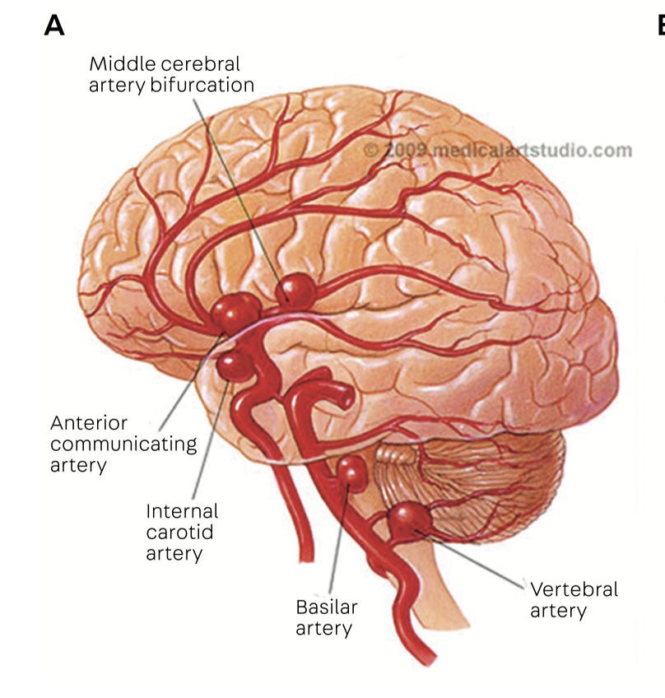
Clinical presentation
Thunderclap headache – ‘worst headache of my life’
Some patients will also have ‘sentinel headache’ = warning headache preceding aSAH by days or weeks
Meningeal signs: photophobia, nuchal rigidity, neck pain
Elevated Intracranial Pressure: nausea, vomiting, stupor, coma
Seizures: blood is a cortical irritant
CN palsies/focal neurological deficits: due to direct compression from aneurysm or blood
Posterior communicating artery: CN III palsy with pupillary involvement
MCA: contralateral face and arm paresis, aphasia, visual neglect
ACA: bilateral leg paresis and Babinski sign
Basilar tip: vertical gaze paresis, bitemporal hemianopsia, bilateral motor paresis, coma

Slide 57
Diagnosis / Work up
Non contrast head CT: initial test of choice
99% sensitive within 6 hours of symptom onset (93% at 24 hours, 50% at 1 week)
CT angiography: useful to evaluate aneurysm location and morphology
CTA unreliable for small <3mm aneurysms
Digital subtraction angiography (DSA): GOLD STANDARD imaging for cerebral vasculature – however this is an interventional neurology procedure
Used for surgical planning and intervention
Lumbar puncture: almost 100% sensitive when done >12 hours after symptom onset
For patients with negative non contrast CT head but high suspicion of SAH
Observe for xanthochromia – yellow appearance of spun down CSF
MRI/MRA: not used in acute period due to time requirements

Slide 58
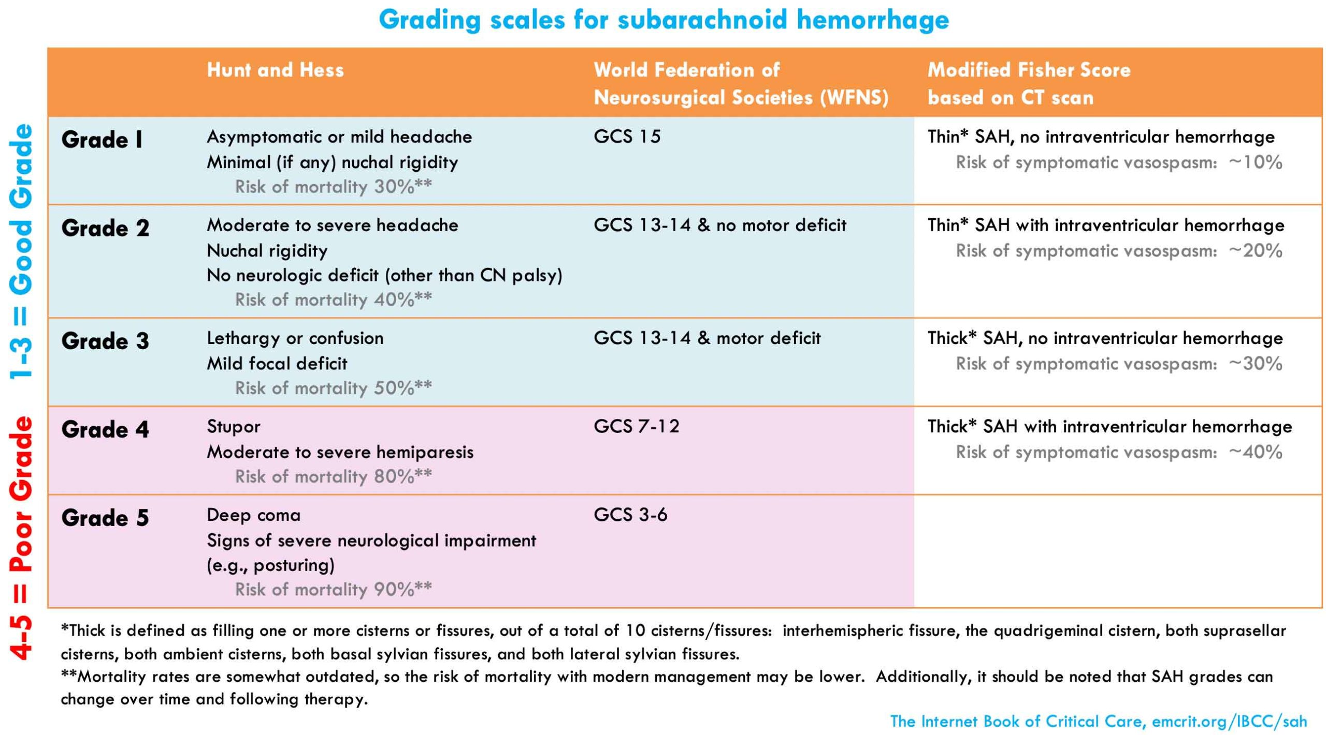
Grading Scales
Clinical and radiographic scales for likelihood of developing complications and outcome prognosis
Clinical: Hunt and Hess, World Federation of Neurological Surgeons
Radiographic: modified Fisher scale

Slide 59
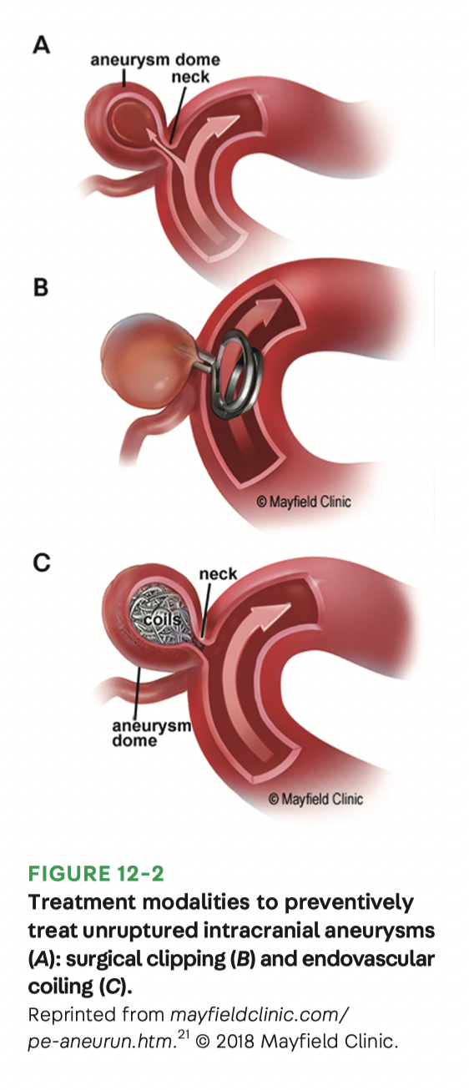
Treatment / management principles
Secure the aneurysm!
Clipping: Craniotomy with surgical ligation
Coiling: endovascular embolization with coils
BP management
Before the aneurysm is secured control hypertension and keep SBP <140 mmHg
Avoid hypotension that may result in secondary brain injury from hypoperfusion

Slide 60
Treatment/ management principles
Hydrocephalus (15-20% of patients with SAH)
Patients will present with decreased level of consciousness, usually have interventricular hemorrhage
Requires placement of an External Ventricular Drain (EVD)
Re-bleeding
Occurs in 4% of patients in first 24 hours if aneurysm is unprotected
Highest risk in 1st day, but up to 2 weeks out
Prevent by securing the aneurysm within first 24 hours
Vasospasm – delayed cerebral ischemia (DCI)
Can occur up to 21 days after SAH
Patients will have sudden neurological deficits on exam
Nimodipine (calcium channel blocker) is only approved drug therapy to reduce vasospasm
May require intra-arterial drug therapy and/or angioplasty

Slide 61
Treatment / management principles
Sodium and volume management
Hyponatremia and hypovolemia are common after SAH and increase risk of complications
Goal is EUNATREMIA and EUVOLEMIA
Seizures
5-20% of patients after SAH
May be the presenting symptom in 8% of patients
Prophylatic anti-epileptic drugs (AEDs) are controversial
Treat seizures if they occur and then continue AEDs for the duration of hospitalization
Low threshold for cEEG to rule out non convulsive status in patients with depressed mental status

Slide 62
Outcomes
~20% of SAH patients treated at experience high volume centers do not survive to discharge
Survivors are disabled by cognitive impairment, long term problems in memory, concentration, executive function, depression, anxiety
Cognitive and physical rehabilitation essential for maximizing recovery

Slide 63
Venous Thrombosis

Slide 64
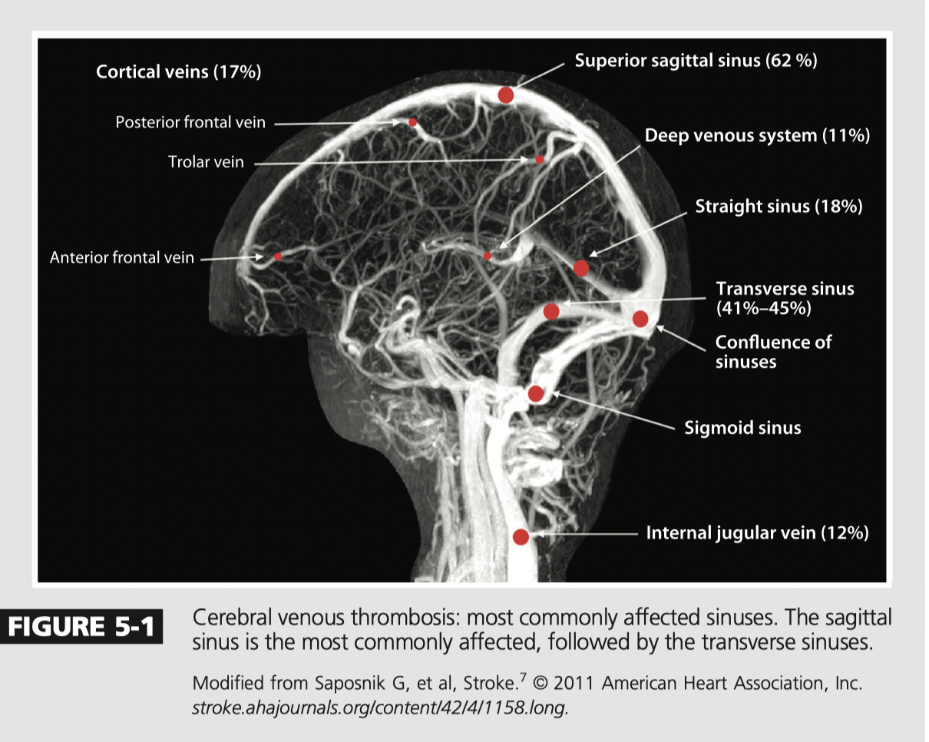
Cerebral Venous Thrombosis
Thrombosis of the dural sinus and/or cerebral veins (CVT)
most commonly affected venous sinus is the superior sagittal (62%) followed by transverse sinus (41% to 45%)
Causes dysfunction by 2 mechanisms:
(1) Localized edema of the brain and venous infarction.
(2) Thrombosis of the major sinuses leads to intracranial hypertension as a result of increased venous pressure and impaired absorption of CSF - hydrocephalus.

Slide 65
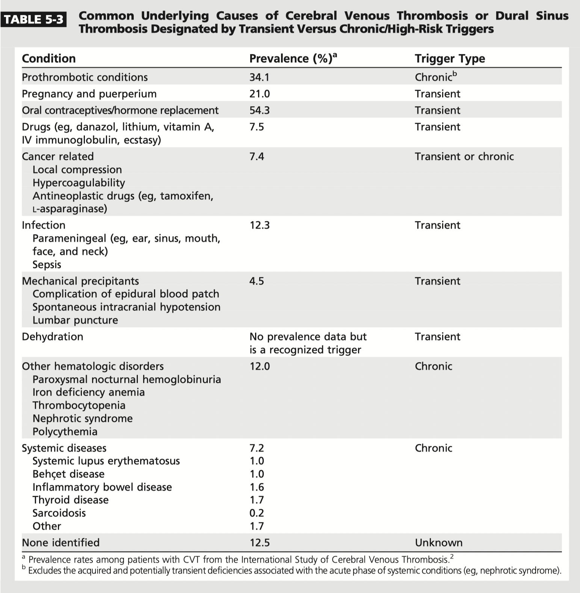
CVT Epidemiology & Risk Factors
Rare type of stroke
0.5% of patients with strokes
Primarily younger individuals age <50 yo, median age 37 yo
75% of CVT cases are in women
Incidence in children is 0.67 per 100,000 per year
43% of those in neonates
Risk Factors: Female Sex (3:1)
65% of identifiable causes of CVT in women related to a risk factor unique to women:
oral contraceptives, pregnancy, post partum period, and hormone therapy.

Slide 66
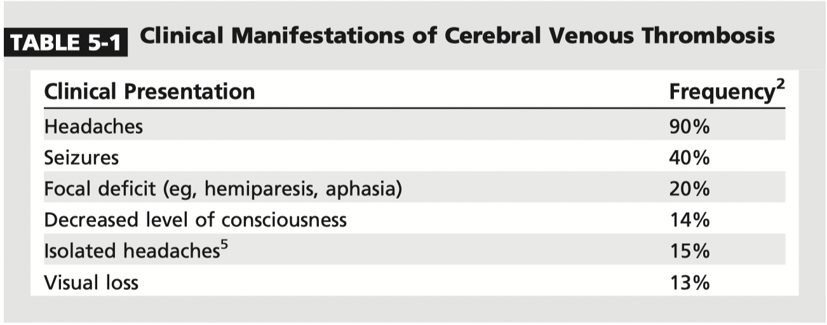
Clinical presentation
(1) isolated intracranial hypertension:
Headache
Diplopia
visual impairment, severe papilledema
decreased level of consciousness
sixth nerve palsy
(2) focal neurologic deficit (eg, motor weakness, sensory deficit, aphasia)
(3) encephalopathy
(4) seizures (with or without a focal neurologic deficit)

Slide 67
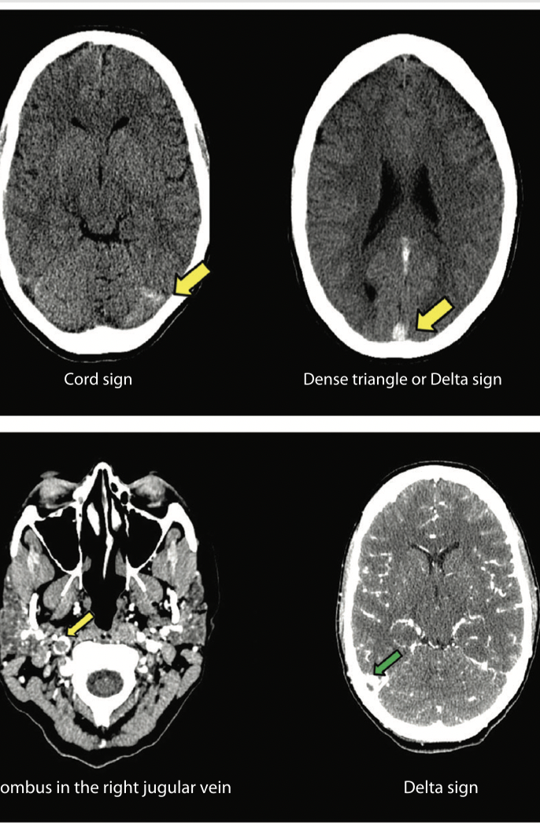
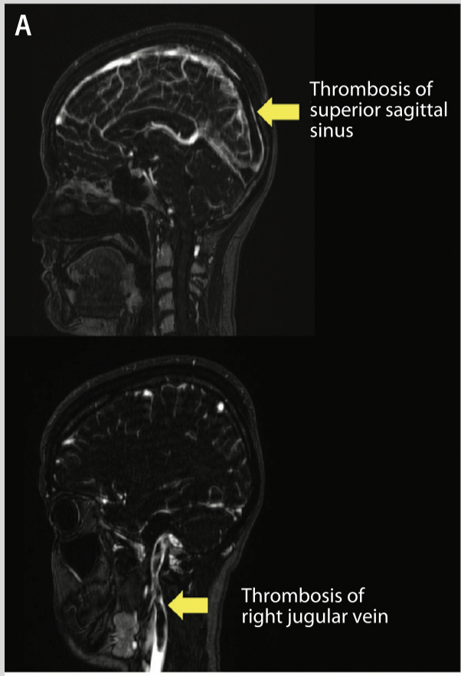
Diagnosis
CT head
High level of clinical suspicion needed
Labs: d-dimer
Elevated in acute phase or with extensive clot
In subacute/chronic phase low d-dimer doesn’t rule out CVT
Imaging:
CT brain
CT venogram
MRI brain
Magnetic resonance venogram (MRV)
Conventional angiogram
CT venogram
MRV

Slide 68
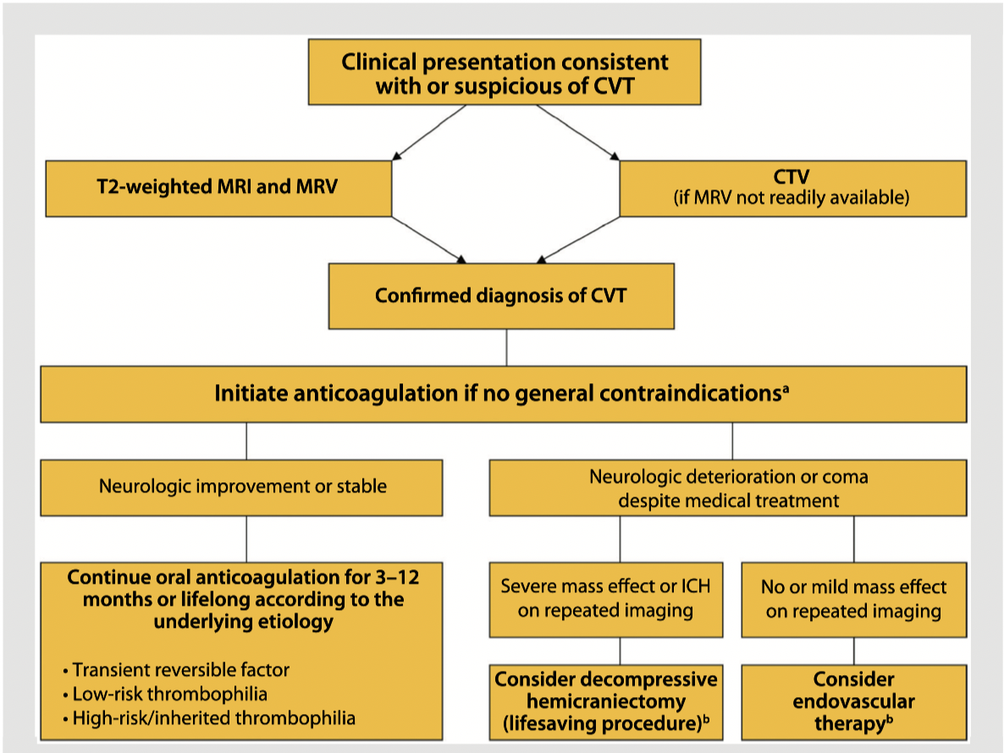
Acute Management
Anticoagulation:
Limited evidence from large RCTs
Used to prevent thrombus growth, to facilitate recanalization, and to prevent other thrombotic events such as deep venous thrombosis and pulmonary embolism
Endovascular Therapy: thrombectomy or thrombolysis
For patients who develop progressive neurologic deterioration despite intensive medical treatment
Decompressive Hemicraniectomy
Should be reserved for young patients who develop a malignant hemispheric stroke due to CVT with progressive neurologic deterioration despite intensive medical treatment.

Slide 69
Management of complications
Seizures
May occur in 1/3 of adults and nearly 1/2 of children with CVT
Factors associated with development of seizures: venous infarction, hemorrhagic conversion, and intracranial hypertension
No evidence for prophylactic use of antiepileptic drugs
Guidelines recommend early initiation of antiepileptic drugs in patients 1 or more seizures
Hydrocephalus
Thrombosis of major sinuses (eg, superior sagittal, transverse sinuses) may affect CSF drainage, resulting in communicating hydrocephalus
Treatment includes measures to decrease the production of CSF, recanalization of the thrombosed sinus, and management of intracranial hypertension.
Neurosurgical consultation for evacuation of CSF either with ventriculostomy or ventriculoperitoneal shunt may be necessary
Intra-cranial Hypertension
Visual Loss
Seen in 15%-40% of patients with CVT
Caused by venous outflow obstruction and CSF malabsorption. Treatment: No RCTs have tested these interventions
Diuretics (ie, acetazolamide)
Serial lumbar punctures
In refractory cases, lumboperitoneal shunt may be required
Due to pressure on the optic nerves
Reported in up to 13% of patients
Treatment:
Ophthalmic consultation
Monitor for papilledema
Visual field testing
For patients at high risk of blindness, optic nerve fenestration may be considered

Slide 70
Prognosis
Outcomes after CVT are generally favorable
Women do better than men if they had a sex-specific risk factor
In one study 81% of women had complete recovery versus 71% of men
Women without sex-specific risk factors tended to have a worse outcome than women with these risk factors (OR for poor outcome 3.7; 95% CI, 1.9 to 7.4)
Risk of any thrombotic event after a CVT is about 6.5% per year (DVT, PE, Stroke, etc)
Chronic anticoagulation: Depends on risk factors
Provoked CVT: 3-6 months of anticoagulation
Unprovoked CVT: 6-12 months of anticoagulation warfarin
Recurrent CVT, venous thromboembolism after CVT, or first CVT (provoked or unprovoked) with severe thrombophilia: indefinite anticoagulation may be considered

